Slide 1
Pro Bono Publico
Drug Trends in Central Nebraska
Presented to ESU 9 TLC
TRUSTWORTHY PROFESSIONAL HONEST RELENTLESS COMMITTED DEPENDABLE

Slide 2
Inv. Dan Fiala
1988
Grand Island Senior High
2019-Present
Investigator TRIDENT Drug Task Force
1997
Trooper
1999
Drug Task Force
Liquor Division
Criminal Division

Slide 3
Some facts and opinions
Some of this information is based on statistics and some is based on my opinions.
My opinions are based on my training and experiences but are not always representative of my agency.
Info is primarily from the Grand Island & Central Nebraska area

Slide 4
Drug Trends
Meth - #1 hard drug of choice
Nearly all comes from Mexican cartels
Border issue: shipments controlled by cartels
$50-100 gram
Marijuana - most widely used
“Everyone is doing it” mentality
HUGE problem among youth - vape
De-criminalized in NE.
Legal in most states (39?)
Federal Schedule 1: no accepted medical use

Slide 5
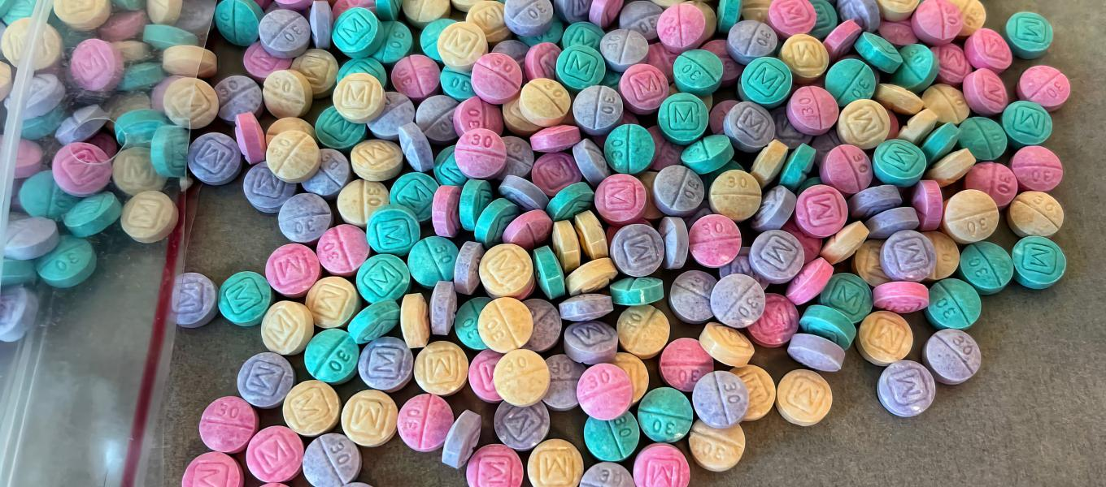
Drugs Trends continued…
Fentanyl - popular in recent months; many *overdoses
Synthetic opioid. Painkiller. 10x stronger than heroin
Originally produced in China
Now produced by MX cartels
Blue “M30” & Rainbows
Pressed by MX cartels
Everything depresses/lowers
BP, Heart rate, Breathing rate
Strange pull to “live on the edge of death”
They know it can kill them
Narcan: be prepared to use it

Slide 6
Houston…we have a problem!

Slide 7
Additional OD statistics vs. Nebraska
Statewide
Grand Island area
2022
29 fatal (25 no NARCAN)
76 non-fatal (51 had NARCAN)
2021
38 fatal (34 no NARCAN)
45 non-fatal (30 single dose NARCAN)
2022
5 fatal
12 non-fatal
2021
1 fatal
1 non-fatal

Slide 9
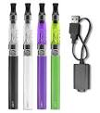
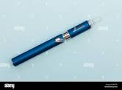
Vape pens
Very popular among students!
Easy to conceal
Shirt sleeve, waistband
Vape dissipates quickly
Nicotine
Various flavors
Youth targeted
THC from marijuana

Slide 10
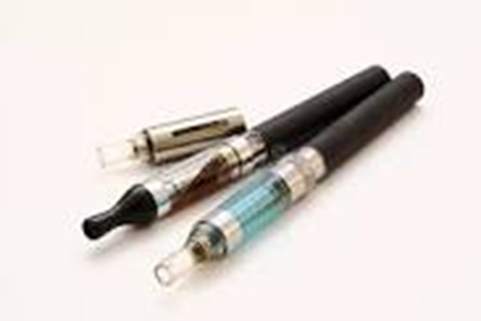
Vape continued
Perception: not as bad as smoking
Addictive: what to watch for
Anxiety
Panic attacks
Buying from older teens: post-HS youth
Near schools
Parking lots

Slide 11
Marijuana & THC products
Also popular: perceived as “not a big deal”
Legal in some way, majority of states (39?)
Goes with risky behaviors
THC products: Dabs, Vape cartridges
Easy to hide
Less mess
Low odor

Slide 12
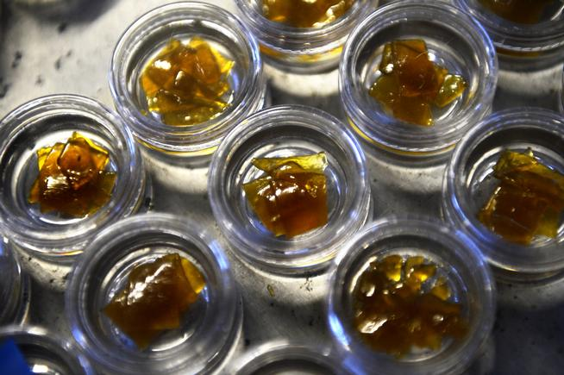
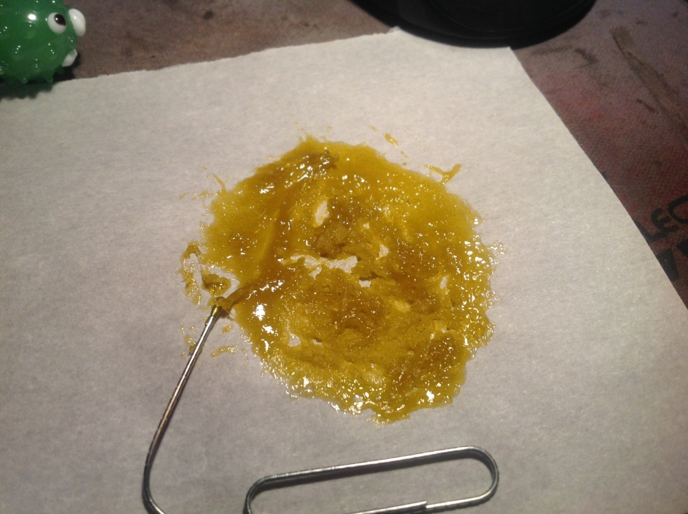
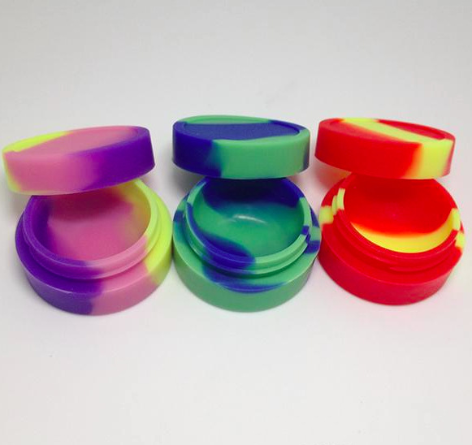
Hash Oil
Hash Oil is usually stored or packaged in small plastic containers similar in size to Carmex Lip Balm containers. It is also found in small silicone containers, or folded up in paper, usually wax paper.

Slide 13
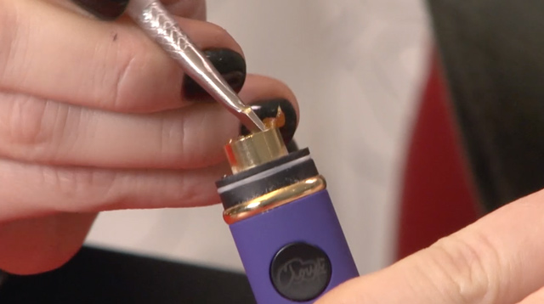
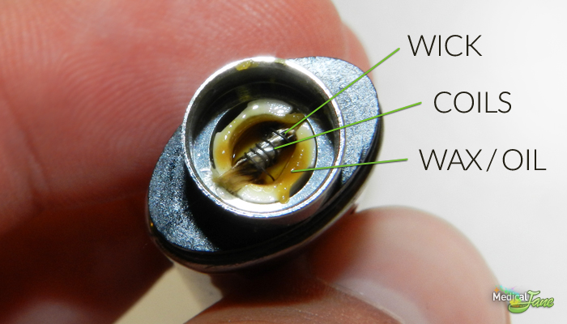
Dabbing With Vape Pens

Slide 14
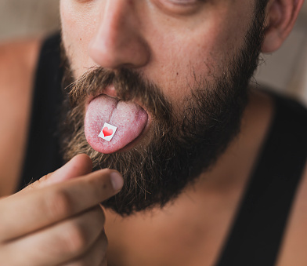
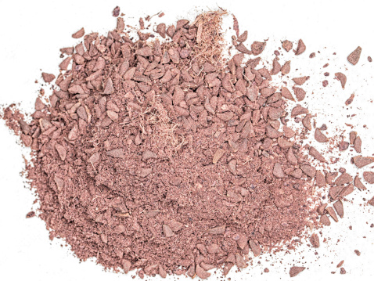
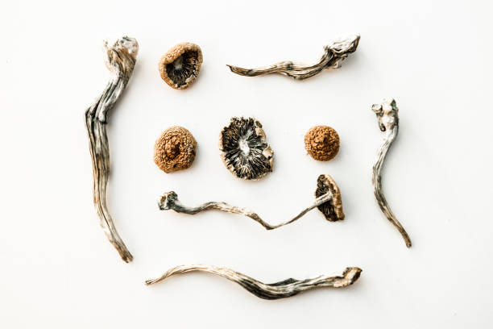
Some Marijuana users also try…
Hallucinogens: a resurgence
History repeating itself
Youth don’t understand the effects; did not live through 60’s and 70’s
LSD
Chemically created
Shrooms
Psilocybin mushrooms
DMT
Extracted from root/bark of a plant

Slide 15
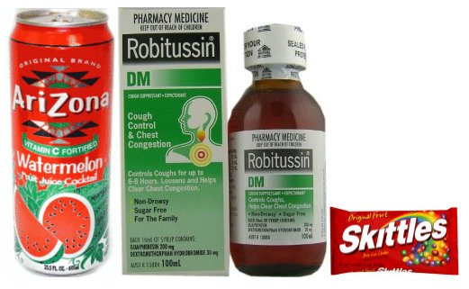
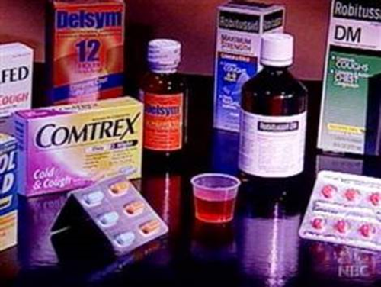
Purple
Drank
Also known as “Sizzurp” – “Lean” – “Robotripping”
Can be mixed with prescription-strength cough and cold medicine that contain codeine or OTC medicines that contain Dextromethorphan (DXM).
Common sources for DXM are Alka-Seltzer Plus Cold & Cough, Coricidin Cough & Cold, CVS Tussin DM, Mucinex DM, Robitussin DM, Sucrets, Sudafed, and Vick’s Dayquil/Nyquil
Usually mixed with Sprite/Mt. Dew or Arizona flavored drinks, jolly ranchers or skittles, and drank from Styrofoam cups.

Slide 16
Purple Drank with codeine provides effects similar to narcotics.
Purple Drank with DXM at dose-dependent levels provides different effects:
Plateau 1: Mild Stimulation
Plateau 2: Euphoria & Hallucinations
Plateau 3: Loss of motor coordination & Distorted visual perceptions
Plateau 4: Out-of-body sensations
In high doses, DXM can exhibit similar effects to those of Dissociative Anesthetics such as PCP and Ketamine.
Mostly being abused by teenagers and young adults.

Slide 17
What can you do?
See something – Say something
Details matter – when you report
Look for small clues
Know your students: recognize problems & addictions
Changes in behavior
Students & their families

Slide 18
Questions?

