Slide 1
Best Version of You
Renae Foster
Mary Lanning Healthcare
Certified Strengths Coach
Relator Achiever
Strategic Belief
WOO Developer
Communication Arranger
Individualization Positivity

Slide 2
Let’s Talk Strengths

Slide 3
Hiring With Purpose
Talent: a recurring pattern of thought, feeling, or behavior that can be productively applied.
Strength: the ability to provide consistent, near-perfect performance in a specific activity.
Skill: the capacity to perform the fundamental steps of an activity.
Knowledge: what you know, either factually or through awareness gained by experience.

Slide 4
Hiring for Talent
Innate Talent
Higher Engagement
Lower Turnover
Recommend employees are two times more likely to be high performers

Slide 5
Does Strengths Based Development Work?
2900
Words per minute
350
90
150
Avg Reader
Above Avg Reader

Slide 6
Invest in Talents
Talent X Investment = Strength
Investment (Skill, Knowledge & Experience)
Invest in A Talent you get an A+
S + K + E = Damage Control
Invest in C Talent you might get a C+
***not an excuse to NOT meet your expectations or Not an excuse to NOT try

Slide 7
STAND UP IF YOU ALWAYS …
talk to people in elevators, airplanes, grocery stores, and wherever you go
have a color-coded or otherwise organized closet
write down a list of things to do, and stick to it
make a list of things to do on weekends
need to pick someone to race while driving
ask too many questions
push the elevator button to “remind” the elevator that you are there

Slide 8
Is it a Strength
Do you feel you always knew how to do it?
When you practice it, do you get better at it?
Do you know you can perform it well?
Can you get paid well for doing it?
Do you feel pride and pleasure when you do it?

Slide 9
Kids, how was school today?

Slide 10
PEOPLE WORKING IN THE STRENGTHS ZONE …
look forward to going to work
have more positive than negative interactions with coworkers
treat customers better
tell their friends they work for a great company
achieve more on a daily basis
have more positive, creative, and innovative moments

Slide 11
People who focus on using their strengths…
Why Does it Matter
are six TIMES as likely to be engaged in their jobs
People who learn to use their strengths every day have 7.8% greater productivity.

Slide 12
Scenario—Planning a football practice

Slide 13
Quarterback
Competition and Self Assurance
Both Influencing strengths
What might this look like
How might his behavior be perceived

Slide 14
Quarterback
Empathy and Developer
Both Relationship Building Strengths
What might this look like
In combination with two Influencing Strengths
How could a coach/teacher capitalize on this player

Slide 15
Grading Assignments

Slide 16
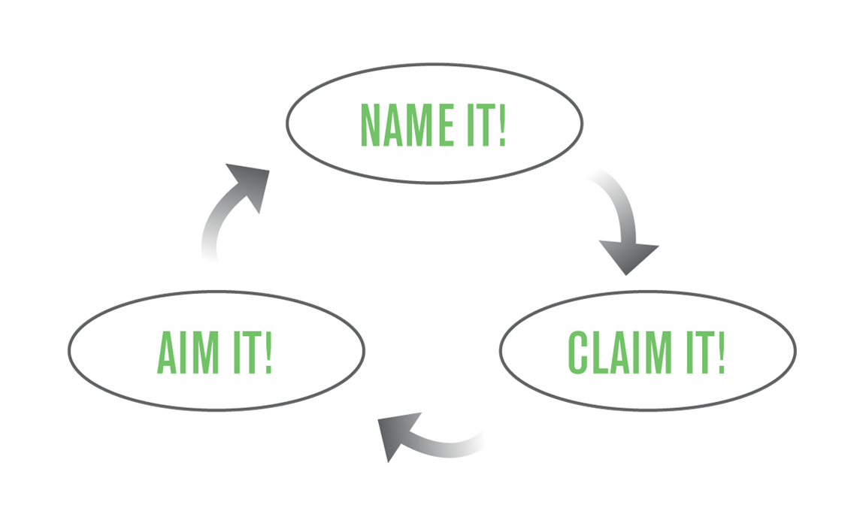
Knowing Your Own Strengths
Help and Hinder
Working with others
Manage my lesser talents (not weakness fixing)
Finding Partners

Slide 17
NOT A Job Finder
Do teachers need to have empathy?
Career Pathway—Not Job Finder

Slide 18
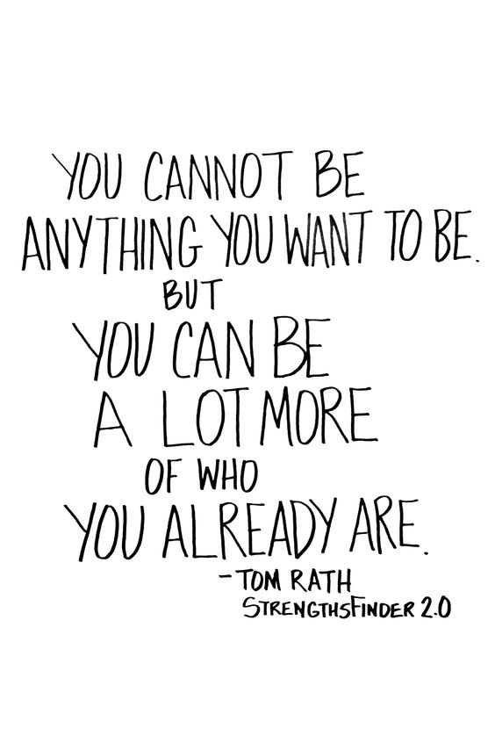
Why Clifton Strengths
Neighborhood vs furniture in the house
What do you believe you do well and own it.
Where’s your chance at making an impact.
Raw vs Mature
Safe Language
Understanding of why others struggle and succeed

Slide 19
Guiding Principals
Themes are neutral
Themes are not labels
Lead with positive intent
Differences are advantages
People need one another

Slide 20
Key to Success
The key to success is to fully understand how to apply your greatest talents and strengths in your everyday life.
Famous People using their talents are not “well rounded”
Simone Biles/Michael Jordan/Kevin Durant (beyond athleticism they have a competitive drive)
Oprah Winfrey/J.K Rowling (connect with an audience in an influential way)
Nelson Mandela (inspired people to see a dream)
Individuals should sharpen talents, teams should be well-rounded.

Slide 21
Career Readiness
It’s ok not to know
Will I be able to do what I do best = JOY
Write with dominate vs non dominate hand
Scholarships and essay
Good with People and Organized
Interview ready

Slide 22
Active Avenues for Strengths
StrengthsQuest.com and gallup.com/cliftonstrengths and Strengths Explorer
UNL Twitter @UNLStrengths (Clifton Strengths Institute) https://business.unl.edu/current-students/clifton-strengths-institute/
K-State Twitter @kstatestrengths
https://www.youtube.com/watch?v=jDzLqgExH68
Hastings College
Strengths Based Parenting
Wellbeing and Engagement, Clifton Builders (Entrepreneur)
https://www.youtube.com/watch?v=EvaX-IwYRrI
https://www.strengthsquest.com/home.aspx

Slide 23
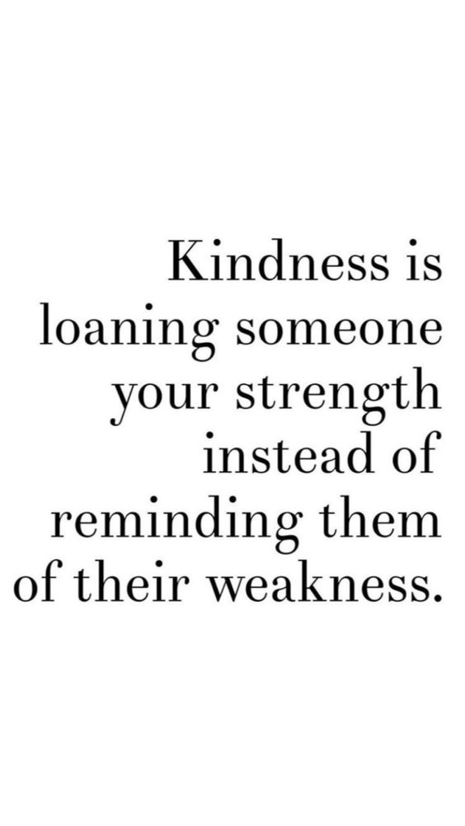
What’s Next—Its Contagious
Take assessment-Need a Code
Assessment-Coaching-Team Coaching
Contact Me
Become a Coach
Don’t dabble—do it☺

Slide 24
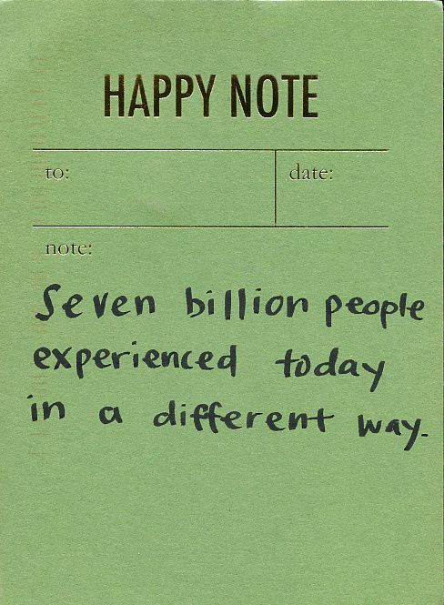
Thank You!
Renae Foster,
rfoster@marylanning.org
402-461-5299
Twitter @foster_renae

