Slide 1
TLC 2021
QR Codes

Slide 2
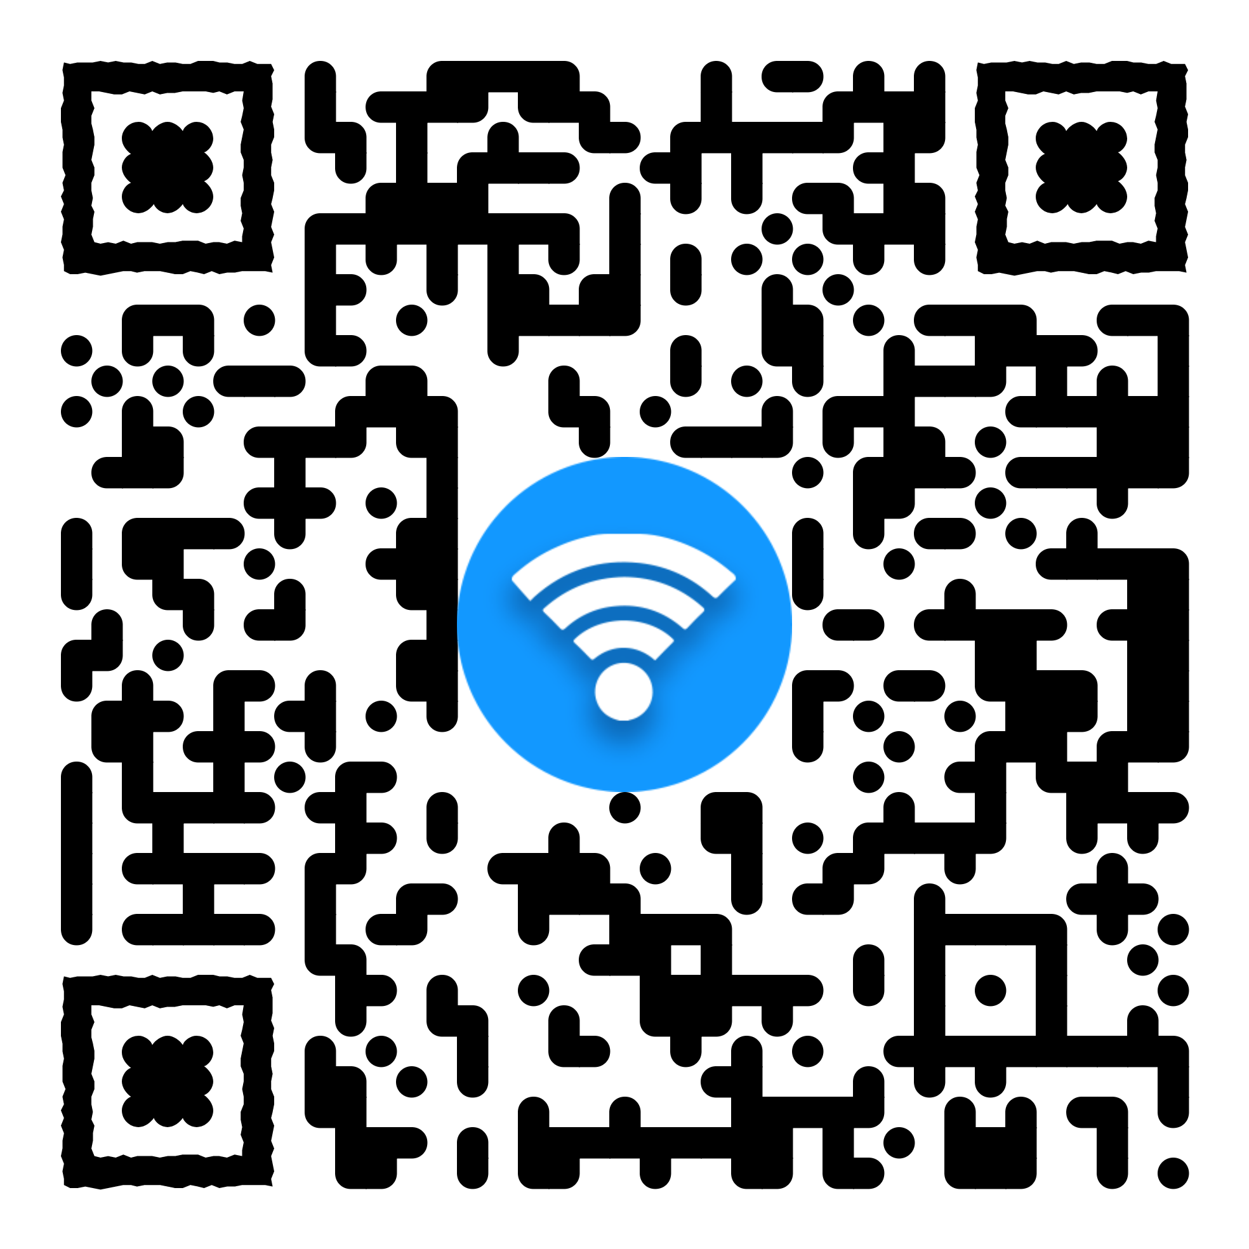
What is a QR Code?
QR = Quick Response Code
Invented in 1994
A storage medium
Can be used for a lot of different things
Websites
Contact Info
Phone number
Email
Address
Website
Wi-Fi
Events
PDFs
Notes:
Scan this code for guest Wi-Fi

Slide 3
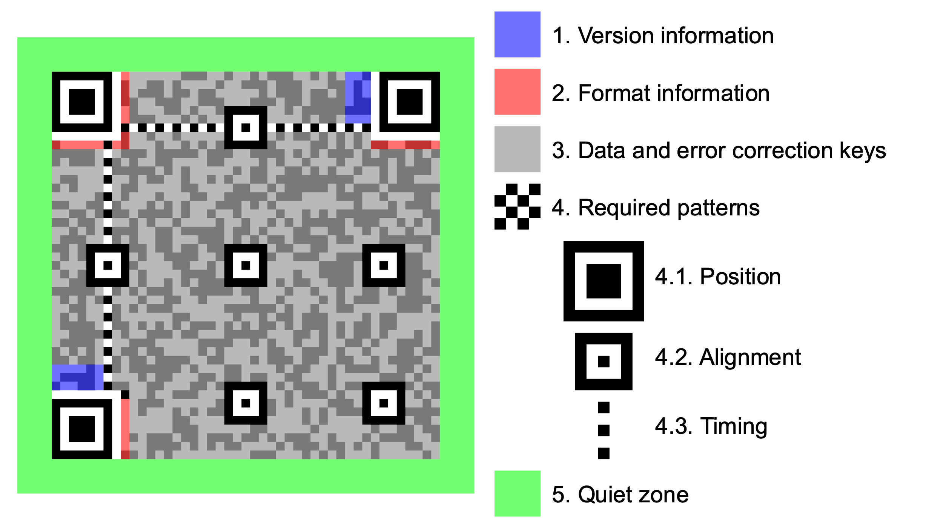

Slide 4
Different types of qr codes
Static
Dynamic
Cannot be changed
No internet needed
Free to create
Can be changed
Can be tracked
Internet required
Usually cost money
Notes:
Dynamic uses a URL to access the information

Slide 5
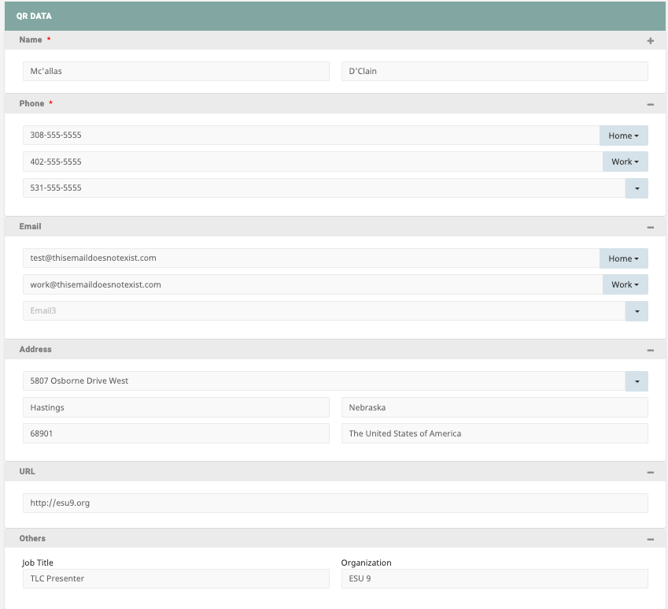
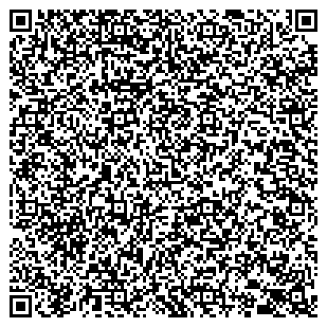
CONTACT INFORMATION
You can put contact info on your QR Code.
Email, phone, name, address…
Notes:
If this code gets loose then anyone can copy and use it.

Slide 6
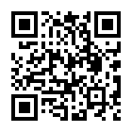
What Could be Bad About QR Codes?
Phishing!!!! (QRishing)
You wouldn’t use a random Flash Drive
They can be placed anywhere
Check URL before opening a link
Think Before you scan
Notes:
Be careful of shortened URLS

Slide 7
Fun Facts
QR Codes can be any color
There are 40 versions of QR Codes
The higher the version the more data can be stored
QR Codes can have logos on them
QR Codes have error correction
How much data can be stored?
3 Kb of data =0.000000375 GB
7,089 numeric characters
4269 alphanumeric characters
Notes:
Kilobit of data

Slide 8
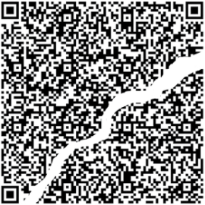
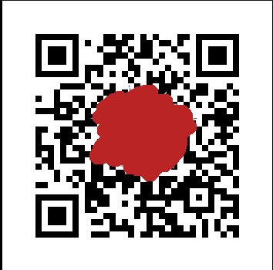
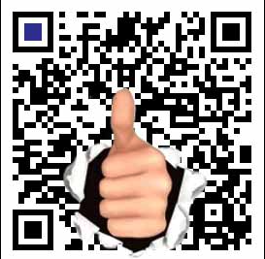
Error Correction
Most QR Codes have 15% error correction
Can have up to 30% error correction
Works like magic
***CANNOT GUARANTEE LEGITIAMACY***
Notes:
Think of when higher and lower error correction should be used

Slide 9
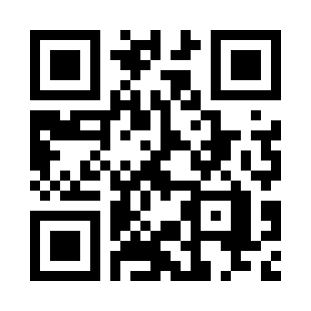
Create your own QR Code
https://qr-creator.com/
Other Websites:
https://www.the-qrcode-generator.com/
https://www.qr-code-generator.com/
https://www.qrcode-monkey.com/

